Slide 1

EXISTING SMART CITY DEVELOPMENT USING DRONE

Slide 2
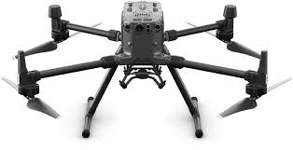
Infrastructure Monitoring
1. Battery
Type: LiPo 6S (Lithium Polymer)
Capacity: 6,500 mAh
Max Flight Time: Up to 55 minutes (varies with payload)
Charging Time: Approximately 60 minutes with a standard charger
2. Camera Options
Zenmuse H20 Series: Integrated payload options
  H20:
    Camera: 12 MP wide-angle, 20 MP telephoto
    Video: 4K at 30 fps
  H20T:
    Thermal Camera: 640 x 512 px resolution
    Laser Rangefinder: Up to 1200 m
    Video: 4K and thermal video capabilities
3. Motors
Type: Brushless motors
Propeller Size: 17 inches (430 mm)
DJI Matrice 300 RTK
DJI Matrice 300 RTK is manufactured by DJI (Dà-Jiāng Innovations Science and Technology Co., Ltd.), a Chinese company headquartered in Shenzhen, Guangdong Province, China.
Additional Highlights
Max Payload: 2.7 kg (6.0 lbs)
Max Speed: 23 m/s (51.5 mph)
Wind Resistance: Up to 15 m/s (33.5 mph)
Obstacle Sensing: 6-directional sensors

Slide 3
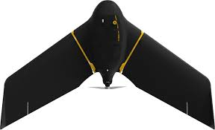
1. Battery
Type: LiPo (Lithium Polymer)
Capacity: 14,000 mAh
Max Flight Time: Up to 90 minutes (depending on payload and conditions)
Charging Time: Approximately 60 minutes with a standard charger
2. Camera Options
Compatible Sensors:
  S.O.D.A. 3D: 20 MP RGB camera for high-resolution mapping.
  S.O.D.A.: 16 MP RGB camera optimized for photogrammetry.
  Thermal Camera: Various options available for thermal imaging.
  Multispectral Camera: For agricultural monitoring (e.g., MicaSense RedEdge).
3. Motors
Type: Electric brushless motors
Configuration: Fixed-wing design with a wingspan of 104 cm (40.9 inches)
senseFly eBee X
The senseFly eBee X is manufactured by senseFly, a Swiss company that specializes in drone solutions for mapping and surveying.
Additional Highlights
Max Payload Capacity: Up to 1.5 kg (3.3 lbs)
Range: Can cover areas up to 200 hectares (494 acres) in a single flight, depending on altitude and sensor.
Flight Mode: Fully autonomous flights using pre-planned missions via eMotion software.
GPS Accuracy: Sub-meter accuracy with optional RTK/GNSS for enhanced precision.

Slide 4
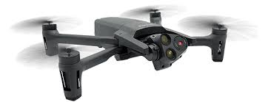
Traffic Management
Parrot Anafi USA
1. Battery
Type: LiPo (Lithium Polymer)
Capacity: 3,500 mAh
Max Flight Time: Up to 32 minutes
Charging Time: Approximately 90 minutes with the standard charger
2. Camera Options
Main Camera:
  Sensor: 32 MP RGB camera
  Video Resolution: 4K HDR at 30 fps
  Zoom: 32x digital zoom
Thermal Camera:
  Sensor: FLIR thermal sensor
  Resolution: 320 x 256 pixels
  Temperature Range: -20°C to 400°C (-4°F to 752°F)
3. Motors
Type: Brushless motors
Configuration: Quadrotor design with a compact form factor
The Parrot Anafi USA is manufactured by Parrot SA, a French company known for its innovative drone solutions.
Additional Highlights
Max Payload Capacity: Not specifically rated for additional payloads; designed for integrated cameras.
Wind Resistance: Up to 15 m/s (33.5 mph)
Transmission Range: Up to 4 km (2.5 miles) with the Skycontroller 3
Weight: Approx. 500 g (1.1 lbs)
Operating Temperature: -10°C to 40°C (14°F to 104°F)

Slide 5
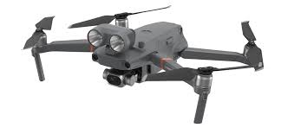
1. Battery
Type: LiPo (Lithium Polymer)
Capacity: 3,800 mAh
Max Flight Time: Up to 31 minutes (depending on conditions and payload)
Charging Time: Approximately 90 minutes with the standard charger
2. Camera Options
Main Camera:
  Sensor: 12 MP wide-angle camera
  Video Resolution: 4K at 30 fps
Thermal Camera:
  Sensor: FLIR radiometric thermal sensor
  Resolution: 160 x 120 pixels
  Temperature Range: -20°C to 400°C (-4°F to 752°F)
  Frame Rate: 30 Hz
3. Motors
Type: Brushless motors
Configuration: Quadrotor design
DJI Mavic 2 Enterprise Dual
The DJI Mavic 2 Enterprise Dual is manufactured by DJI (Dà-Jiāng Innovations Science and Technology Co., Ltd.), a Chinese company headquartered in Shenzhen.
Additional Highlights
Max Payload Capacity: Designed for integrated sensors; additional accessories available (e.g., spotlight, speaker).
Wind Resistance: Up to 29-38 km/h (18-24 mph)
Transmission Range: Up to 8 km (5 miles) with OcuSync 2.0
Weight: Approx. 905 g (2 lbs)
Operating Temperature: -10°C to 40°C (14°F to 104°F)

Slide 6
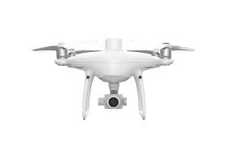
Environmental Monitoring
DJI Phantom 4 RTK
1. Battery
Type: LiPo (Lithium Polymer)
Capacity: 5,350 mAh
Max Flight Time: Up to 30 minutes (varies based on conditions and payload)
Charging Time: Approximately 60-70 minutes with the standard charger
2. Camera Options
Sensor: 1-inch 20 MP CMOS sensor
Video Resolution: 4K at 60 fps
Lens: 24 mm equivalent focal length, f/2.8
Image Formats: JPEG, DNG (RAW)
Max Image Size: 5472 x 3648 pixels
3. Motors
Type: Brushless motors
Configuration: Quadrotor design
The DJI Phantom 4 RTK is manufactured by DJI (Dà-Jiāng Innovations Science and Technology Co., Ltd.), a prominent Chinese drone manufacturer based in Shenzhen.
Additional Highlights
Max Payload Capacity: Designed primarily for the integrated camera; supports RTK module for enhanced accuracy.
Wind Resistance: Up to 10 m/s (22 mph)
Transmission Range: Up to 7 km (4.3 miles) with Lightbridge HD
Weight: Approx. 1,380 g (3.04 lbs)
Operating Temperature: 0°C to 40°C (32°F to 104°F)

Slide 7
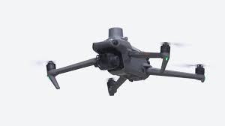
Public Safety and Emergency Response
1. Battery
Type: LiPo (Lithium Polymer)
Capacity: 5,000 mAh
Max Flight Time: Up to 45 minutes (varies based on conditions and payload)
Charging Time: Approximately 90 minutes with the standard charger
2. Camera Options
Main Camera:
  Sensor: 4/3 CMOS sensor (Hasselblad)
  Photo Resolution: 20 MP
  Video Resolution: 5.1K at 50 fps, 4K at 120 fps
Telephoto Camera:
  Sensor: 1/2-inch CMOS
  Zoom: 28x hybrid zoom
  Video Resolution: 4K at 30 fps
3. Motors
Type: Brushless motors
Configuration: Quadrotor design
DJI Mavic 3 Enterprise
The DJI Mavic 3 Enterprise is manufactured by DJI (Dà-Jiāng Innovations Science and Technology Co., Ltd.), a leading drone manufacturer based in Shenzhen, China.
Additional Highlights
Max Payload Capacity: Designed primarily for integrated cameras; compatible with various accessories (e.g., speaker, spotlight).
Wind Resistance: Up to 12 m/s (27 mph)
Transmission Range: Up to 15 km (9.3 miles) with OcuSync 3.0
Weight: Approx. 895 g (1.97 lbs)
Operating Temperature: -10°C to 40°C (14°F to 104°F)

Slide 8
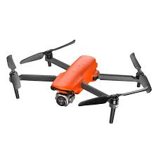
Autel Robotics EVO Lite
1. Battery
Type: LiPo (Lithium Polymer)
Capacity: 7,100 mAh
Max Flight Time: Up to 40 minutes (varies based on conditions and payload)
Charging Time: Approximately 100 minutes with the standard charger
2. Camera Options
Sensor: 1-inch CMOS sensor
Photo Resolution: Up to 50 MP
Video Resolution:
  6K at 30 fps
  4K at up to 60 fps
Lens: 22 mm (equivalent) with f/2.8 to f/11 aperture range
ISO Range: 100 to 12,800 (photo), 100 to 6,400 (video)
3. Motors
Type: Brushless motors
Configuration: Quadrotor design
The Autel Robotics EVO Lite is manufactured by Autel Robotics, an American drone manufacturer based in Bothell, Washington.
Additional Highlights
Max Payload Capacity: Designed for integrated camera; no specified external payload capacity.
Wind Resistance: Up to 15 m/s (33.5 mph)
Transmission Range: Up to 10 km (6.2 miles) with Autel’s secure transmission technology
Weight: Approx. 795 g (1.75 lbs)
Operating Temperature: -10°C to 40°C (14°F to 104°F)

Slide 9
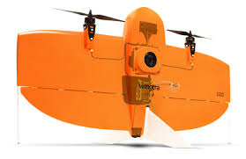
Urban Planning
WingtraOne
1. Battery
Type: LiPo (Lithium Polymer)
Capacity: 5,200 mAh
Max Flight Time: Up to 59 minutes (varies based on payload and conditions)
Charging Time: Approximately 60 minutes with the standard charger
2. Camera Options
Compatible Sensors:
  Sony RX1R II: 42.4 MP full-frame RGB camera for high-resolution mapping.
  Phase One iXM: Various configurations available for different mapping requirements (e.g., 50 MP).
  MicaSense RedEdge: Multispectral camera for agricultural applications.
Image Resolution: Up to 42.4 MP (depending on the camera used).
3. Motors
Type: Electric brushless motors
Configuration: Fixed-wing design with vertical takeoff and landing (VTOL)
The WingtraOne is manufactured by Wingtra, a Swiss company that specializes in professional mapping and surveying drones.
Additional Highlights
Max Payload Capacity: Up to 1 kg (2.2 lbs)
Range: Can cover areas up to 200 hectares (494 acres) in a single flight, depending on altitude and sensor.
Flight Mode: Fully autonomous flights using pre-planned missions via WingtraPilot software.
GPS Accuracy: Supports RTK for centimeter-level accuracy.

Slide 10
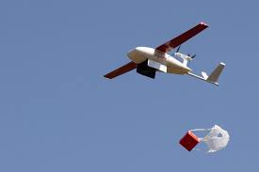
Delivery Services
Zipline Drones
1. Battery
Type: LiPo (Lithium Polymer)
Max Flight Time: Typically up to 3 hours (varies depending on mission and payload)
2. Payload Capacity
Max Payload: Up to 1.75 kg (3.9 lbs) per flight, depending on the model.
3. Camera Options
Basic Camera: Often equipped with a standard camera for navigation and monitoring; specific sensor options can vary by application.
4. Motors
Type: Electric brushless motors
Configuration: Fixed-wing design with vertical takeoff and landing (VTOL) capabilities.
Zipline is the company behind Zipline drones
Additional Highlights
Range: Can cover distances of up to 160 km (99 miles) round trip.
Flight Mode: Operates in fully autonomous mode with pre-programmed delivery routes.
GPS Accuracy: High-precision GPS for accurate navigation and delivery.

Slide 11
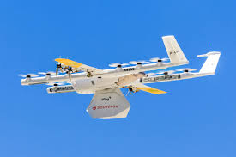
1. Battery
Type: LiPo (Lithium Polymer)
Max Flight Time: Approximately 30 minutes (varies based on payload and conditions)
2. Payload Capacity
Max Payload: Up to 1.5 kg (3.3 lbs) per delivery.
3. Camera Options
Basic Camera: Equipped with cameras for navigation, obstacle avoidance, and monitoring; specific sensor details are not widely publicized.
4. Motors
Type: Electric brushless motors
Configuration: Multirotor design with vertical takeoff and landing (VTOL) capabilities.
Wing (by Alphabet)
Wing is a subsidiary of Alphabet Inc., the parent company of Google.
Additional Highlights
Range: Can cover distances up to 10 km (6.2 miles) from the launch point.
Delivery Speed: Typically around 100 km/h (62 mph) for efficient delivery.
Flight Mode: Fully autonomous with pre-programmed flight paths.

Slide 12
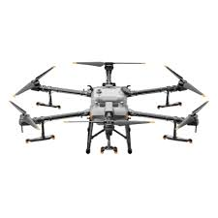
Smart Agriculture
1. Battery
Type: LiPo (Lithium Polymer)
Capacity: 12,000 mAh
Max Flight Time: Up to 30 minutes (varies with payload)
Charging Time: Approximately 60 minutes with the standard charger
2. Payload Capacity
Max Payload: Up to 30 kg (66 lbs) for spraying and other applications.
3. Camera Options
Sensor: Integrated RGB camera for real-time monitoring and mapping (specific details may vary).
Spray System: Advanced spraying system with multiple nozzles for efficient application.
4. Motors
Type: Brushless motors
Configuration: Quadrotor design
DJI Agras T30
The DJI Agras T30 is manufactured by DJI (Dà-Jiāng Innovations Science and Technology Co., Ltd.), a leading drone manufacturer based in Shenzhen, China.
Additional Highlights
Max Operating Range: Up to 6 km (3.7 miles) depending on environmental conditions.
Flight Speed: Up to 10 m/s (22.4 mph) for efficient coverage.
Pesticide and Fertilizer Application: Optimized for agricultural spraying tasks.

Slide 13
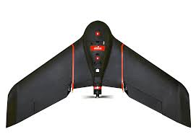
senseFly eBee SQ
1. Battery
Type: LiPo (Lithium Polymer)
Capacity: 14,000 mAh
Max Flight Time: Up to 90 minutes (varies based on payload and conditions)
2. Payload Capacity
Max Payload: Up to 1.5 kg (3.3 lbs)
Compatible Sensors:
  MicaSense RedEdge: Multispectral camera for vegetation analysis.
  S.O.D.A.: 20 MP RGB camera for high-resolution mapping.
3. Motors
Type: Electric brushless motors
Configuration: Fixed-wing design with vertical takeoff and landing (VTOL)
The senseFly eBee SQ is manufactured by senseFly, a Swiss company that specializes in drone solutions for mapping and surveying, and is part of the Parrot Group.
Additional Highlights
Max Range: Can cover areas up to 200 hectares (494 acres) in a single flight, depending on altitude and sensor used.
Flight Mode: Fully autonomous flights using pre-planned missions via eMotion software.
GPS Accuracy: Supports RTK for centimeter-level accuracy.

Slide 14
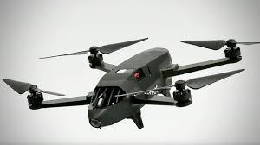
Waste Management
1. Battery
Type: LiPo (Lithium Polymer)
Capacity: 3,400 mAh
Max Flight Time: Up to 25 minutes (varies based on conditions and payload)
Charging Time: Approximately 60 minutes with the standard charger
2. Payload Capacity
Max Payload: Designed primarily for integrated sensors; can carry additional payloads such as multispectral cameras.
3. Camera Options
Main Camera:
  Sensor: 14 MP RGB camera
  Video Resolution: 1080p at 30 fps
Compatible Sensors:
  Parrot Sequoia: Multispectral sensor for crop monitoring and analysis.
4. Motors
Type: Brushless motors
Configuration: Quadrotor design
Parrot Bluegrass Fields
The Parrot Bluegrass Fields is manufactured by Parrot SA, a French company known for its innovative drone solutions, particularly in agriculture and mapping.
Additional Highlights
Max Range: Up to 2 km (1.24 miles) with enhanced transmission.
Flight Speed: Up to 14 m/s (31 mph).
Flight Mode: Fully autonomous with pre-planned missions via the Parrot FreeFlight Pro app.

